Slide 1
Access Advanced Queries

Slide 2
Parameters in a Query
Queries can be built to work with user supplied input, known as parameters
Use of a parameter is indicated by
  Working in the grid column for the field using the input
  Typing a short string serving as a request for data in criteria row of grid
  Enclosing the request string in [ ] symbols

Slide 3
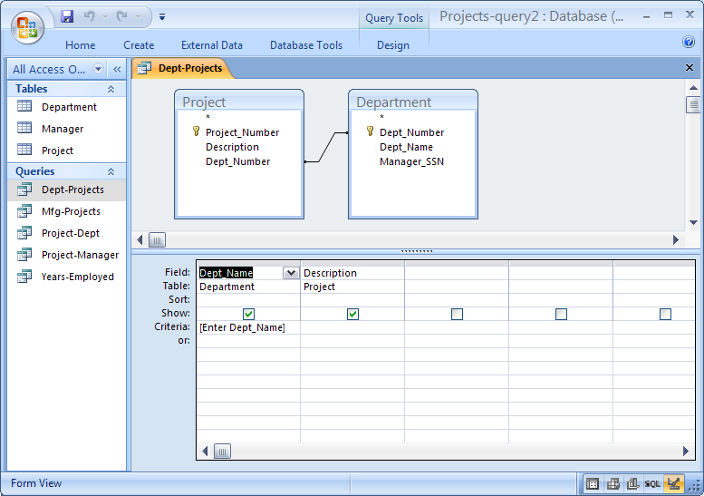
Query : “List projects for a user input department”

Slide 4
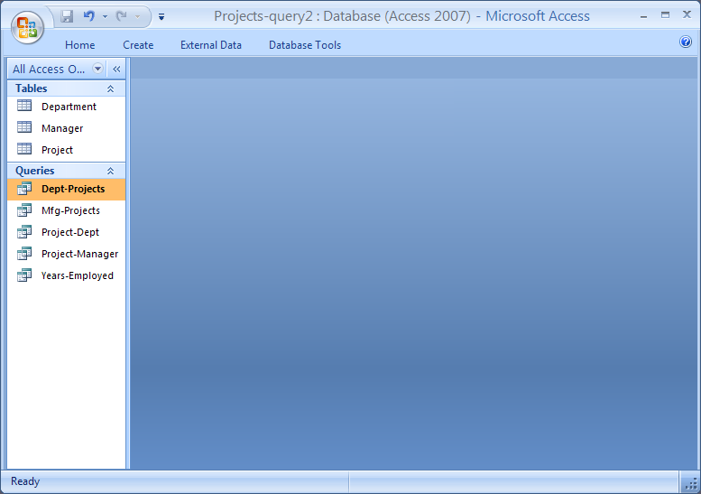
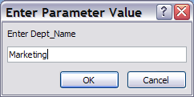
Query : User Prompt for Value to Use

Slide 5
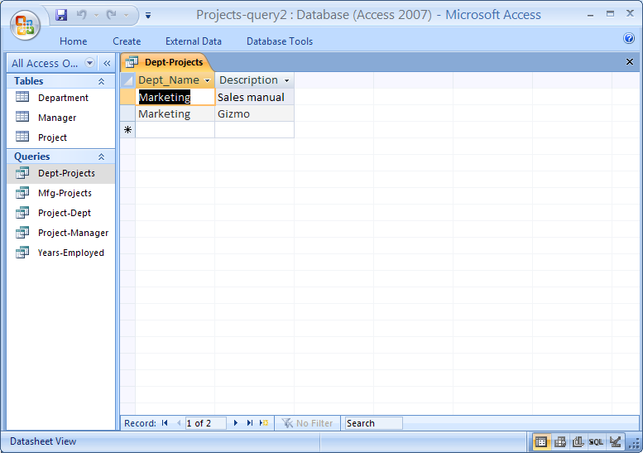
Query : Results only for Input Department

Slide 6
Calculated fields and expressions in Queries
Queries can be built to perform a calculation as part of the query
Calculation expressions are entered in the field row of the design grid
  Expression can be typed
  Expression Builder can be used
  Similar to Excel and VBA math expressions
  Table fields are referenced with [ ] symbols
A label is assigned to the column for display purposes
  Label is pre-pended to expression and set off by a :

Slide 7
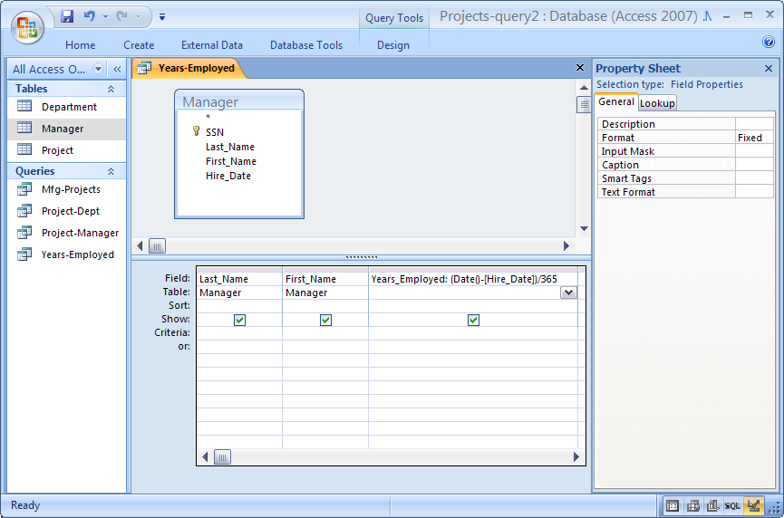
Query : “Years of employment for each manager”

Slide 8
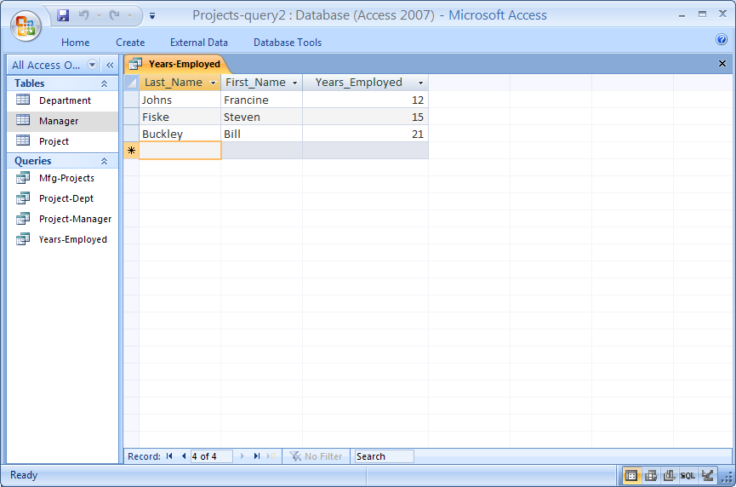
Query : Results

Slide 9
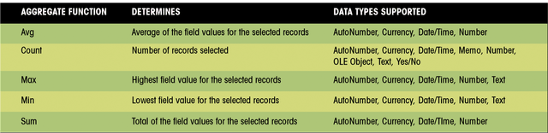
“Totals” Query
These are used to summarize information about many rows of detailed information
Requires:
  Group By field – all rows with same data in this field will be summarized
  Summary aggregate function field – all data in this field will be used in calculation
Similar summary capabilities built into reports

Slide 10
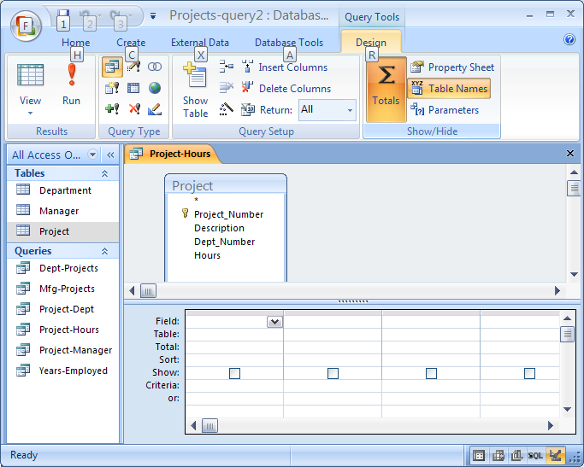
Query : “Total hours by project” - Totals Type

Slide 11
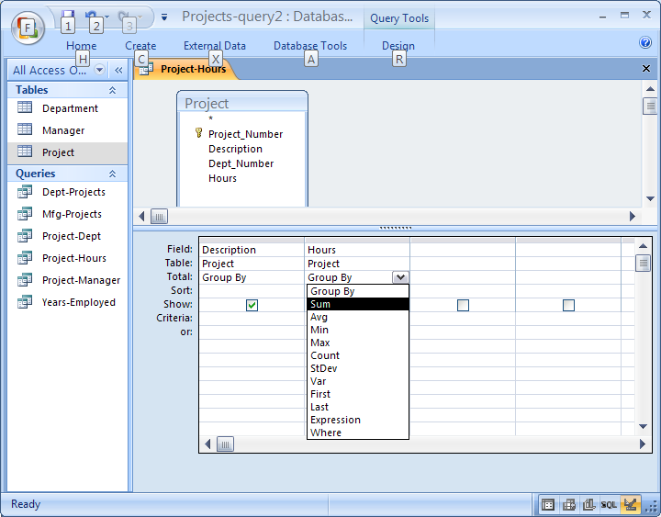
Query : Group By and Sum fields

Slide 12
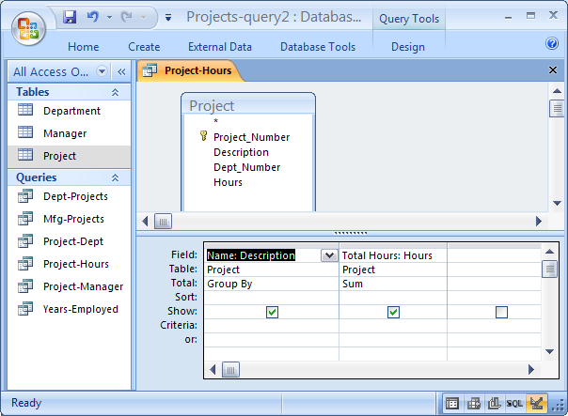
Query : Informative Column Labels

Slide 13
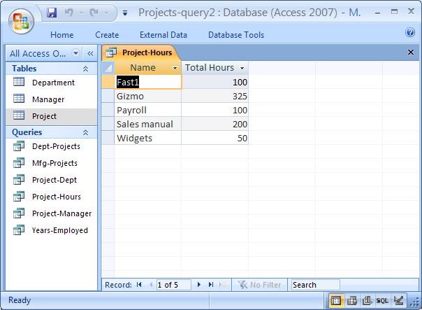
Query : Results

Slide 14
END

